Slide 1
C#
MLC
C
UDP
UDP
Teensy
HES
I2C
RTOS
C++
LabVIEW
Oran’s fancy chip
Encoders
Serial
Pots
FPGA
Motors
LabVIEW

Slide 2
Control Box Connections

Slide 3
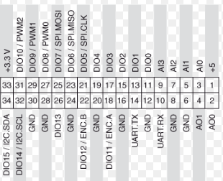
A
Motor 1 PWM
Motor 1 en/dis
Motor 1 Dir
B
Motor 2 PWM
Reserved for Serial
Oran’s chip
14.12.10
Motor 2 en/dis
Motor 2 Dir

Slide 4
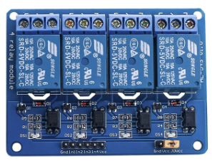
+5V
BDIO1
ADIO1
GND
+24V
Motor 1 Vout
Motor 2 Vout

Slide 5
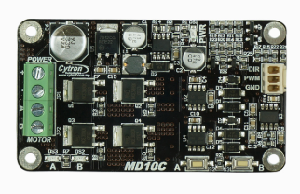
A
B
+5V myRIO
myRIO GND
+24V
external
Motor 1 A
Motor 1 B
GND
external
1
Motor 2 A
Motor 2 B
2

Slide 6
Oran’s Board
Ping/Pong – Send ‘s’ and receive encoder values
Unable to do Serial via FPGA, so this will be VISA on RT only.
Baud rate = 115200

Slide 7
FPGA
Old Responsibilities:
Obtain Pots, Read encoders
FK
Data to RT = pot readings, theta readings, current xy.
Obtain motor directions, enable/disable, gains
Create PWM
Data to motors = PWM, enable, directions
New Responsibilities:
Obtain motor directions, enable/disable, gains
Create PWM
Data to motors = PWM, enable, directions

Slide 8
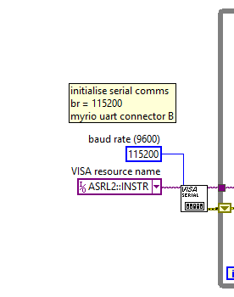
Obtaining data from Oran’s Chip 1.
Initialise Serial communication.
Baud rate is 115200
MyRIO serial comms port is connector B

Slide 9
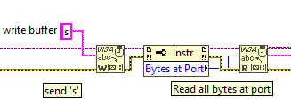
Obtaining data from Oran’s Chip 2.
Write ‘s’ to serial to request data from Oran’s fancy chip
Read all the bytes at the port (there will be 16 bytes)

Slide 10
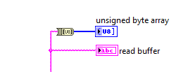
Obtaining data from Oran’s Chip 3.
When reading the buffer, nonsense characters are received.
Convert these to an unsigned byte array.
The data is in the format:
Enc 0 pos
Enc 1 pos
Enc 0 vel
Enc 1 vel

Slide 11
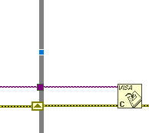
Obtaining data from Oran’s Chip 4.
The session must be closed at the end

Slide 12
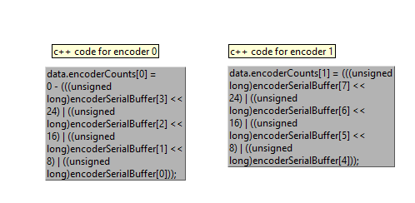
Decoding data from Oran’s Chip 1.
Enc 0 pos
Enc 1 pos
Enc 0 vel
Enc 1 vel
Currently only care about position since the velocities are not working well, so only the first 8 bytes of data are used.
The C++ code for decoding:

Slide 13
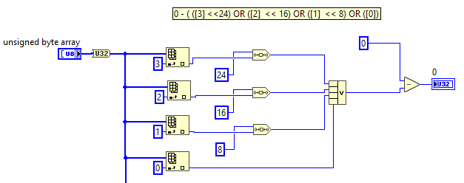
Decoding data from Oran’s Chip 2.
Byte 0
Byte 1
Byte 2
Byte 3
Decoding encoder 0

Slide 14
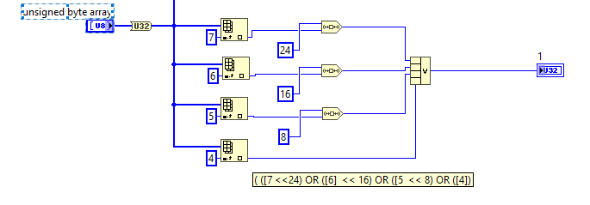
Decoding data from Oran’s Chip 3.
Byte 4
Byte 5
Byte 6
Byte 7
Decoding encoder 1

Slide 15
Decoding data from Oran’s Chip 4.
Thus, we have the counts in each encoder. It is necessary to turn the counts into an angle (rad)
The encoder has 1024 pulses per revolution, or 4096 counts per revolution (because its quadrature)
Shoulder
Elbow
motor
motor
15:1
35:1
Gearbox
Spur1
Gearbox
Bevel1
8:3
2:1
Spur2
Bevel2
40 motor turns = 1 rev = 163840 counts
70 motor turns = 1 rev = 286720 counts

Slide 16
Decoding data from Oran’s Chip 5.
Shoulder
40 motor turns = 1 rev = 163840 counts
1 count = 360/163840 = 0.00219726562 deg = 2π/163840 = 3.83495196097794e-5 rad
Elbow
70 motor turns = 1 rev = 286720 counts
1 count = 360/286720 = 0.00125558035714285714285714285714 deg = 2π/286720 = 2.191401125545480038e-5 rad

Slide 17
Teensy 3.2 to myRIO
Force Sensor I²C Documentation

Slide 18
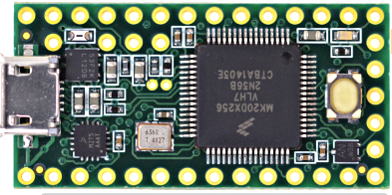
Teensy Connection
SDA
AI3
SCL
AI2
GND
AI1
Vin (+5V)
AI0
+3.3V (Vout)

Slide 19
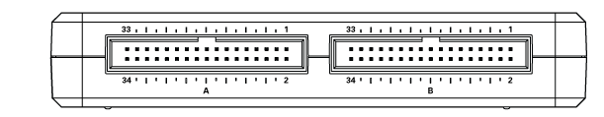
myRIO Connection
+5V (Vout)
GND
SCL
SDA

Slide 20
All Connections.
MyRIO
+5V Vout
SCL
SDA
GND
Teensy
+5V Vin
SCL
SDA
GND
+3.3V Vout
AI0
AI1
AI2
AI3
All HES
GND
+3.3V Vin
HES 1 Vout
HES 2 Vout
HES 3 Vout
HES 4 Vout

Slide 21
Teensy code – Initialisation
#include <Wire.h>
int a = 0; // HES 1 raw voltage reading
int b = 0; // HES 2 raw voltage reading
int c = 0; // HES 3 raw voltage reading
int d = 0; // HES 4 raw voltage reading
volatile byte dataPacket[8]; // array of bytes to send
volatile byte ha = 0; // High byte for HES1
volatile byte la = 10; // low byte for HES1
volatile byte hb = 0; // High byte for HES2
volatile byte lb = 0; // low byte for HES2
volatile byte hc = 11; // High byte for HES3
volatile byte lc = 0; // low byte for HES3
volatile byte hd = 0; // High byte for HES4
volatile byte ld = 13; // low byte for HES4
bytes and byte array declared as volatile, since it is
necessary to inform the compiler that the values may
change via interrupts, so that the compiler
doesn't optimise the code away.

Slide 22
Teensy code – setup function
void setup() {
Wire.begin(1); // join i2c bus with address #1
Wire.onRequest(requestEvent); // register event
}
The event is processed as an interrupt, which is why the bytes were
Declared as volatile.

Slide 23
Teensy code – main loop function
void loop() {
a = analogRead(0); //read raw bits for HES 1
b = analogRead(1); //read raw bits for HES 2
c = analogRead(2); //read raw bits for HES 3
d = analogRead(3); //read raw bits for HES 4
getByte(); // cast to high and low bytes
fillArray(); // build byte array for transfer
delay(1);
}
These 2 functions build the array ready for transfer

Slide 24
Teensy code – getByte() function
void getByte() {
ha = highByte(a);
la = lowByte(a);
hb = highByte(b);
lb = lowByte(b);
hc = highByte(c);
lc = lowByte(c);
hd = highByte(d);
ld = lowByte(d);
}
This function casts the data for each sensor into a high byte, and a low
Byte. This is necessary because the data is greater than 255, or longer than 1 byte
Eg, 566 dec = 0000001000110110 bin
0000001000110110
00000010
00110110
High byte
low byte

Slide 25
Teensy code – fillArray() function
void fillArray() {
dataPacket[0] = ha;
dataPacket[1] = la;
dataPacket[2] = hb;
dataPacket[3] = lb;
dataPacket[4] = hc;
dataPacket[5] = lc;
dataPacket[6] = hd;
dataPacket[7] = ld;
}
This function builds the 8-byte array
00000010
00110110
00000010
00110110
00000010
00110110
00000010
00110110
High byte a
low byte a
High byte b
low byte b
High byte c
low byte c
High byte b
low byte d

Slide 26
Teensy code – I2C Event function
void requestEvent() {
Wire.write((byte*)dataPacket, 8);
}
This function fires when the myRIO (I2C Master) sends a request
For data.
The array of 8 bytes (the data packet) is written to the data line

Slide 27
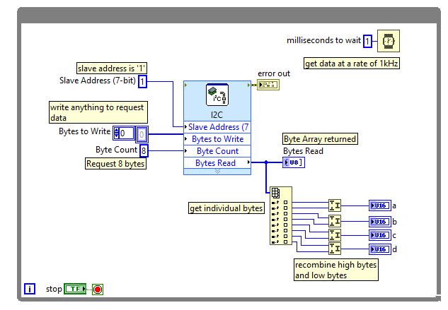
myRIO code

Slide 28
Training the Force Neural Network 1
Can be found in trainNet.m in PhD MATLAB folder.
Init Phase:
clc; % Clear the command window
clear; % Clear the workspace
%%%%%%%%%%%%%%%%%%%%%%%%%%%%%%%%%%%%%%%%%%%%%%%%%%%%%%%%%%%%%%%%
%%%%%%%%%%%%%%%%%%%%%% Get data and process %%%%%%%%%%%%%%%%%%%%
%%%%%%%%%%%%%%%%%%%%%%%%%%%%%%%%%%%%%%%%%%%%%%%%%%%%%%%%%%%%%%%%
%import testdata
sizedata = size(csvread('testdata.csv',1,0));
rawdata = csvread('testdata.csv',1,0,[1,0,sizedata(1),5]);
%randomise row order to limit the risk of local minima
data = rawdata(randperm(size(rawdata, 1)), :);
% data is in the format: force, orientation, raw1, raw2, raw3, raw4

Slide 29
Training the Force Neural Network 2
Can be found in trainNet.m in PhD MATLAB folder.
%Create training vectors
raw1 = data(:,3)/1000; %Raw bits from sensor 1
raw2 = data(:,4)/1000; %Raw bits from sensor 2
raw3 = data(:,5)/1000; %Raw bits from sensor 3
raw4 = data(:,6)/1000; %Raw bits from sensor 4
%Create answer vectors
Fx = (data(:,1).*cos((deg2rad(data(:,2)))));
%Process data to remove any tiny numbers (such as xE-17)caused by trig
c=0;
for count = 1:sizedata(1)
c=c+1;
if Fx(c) <0.01 && Fx(c) > -0.01
Fx(c) = 0;
end
end
Pre-processing, to ensure inputs are between
0 and 1 necessary for neural network training

Slide 30
Training the Force Neural Network 3
Can be found in trainNet.m in PhD MATLAB folder.
%Scale to work nicely with NN maths
Fx = Fx/100;
Fy = (data(:,1).*sin((deg2rad(data(:,2)))));
%Process data to remove any tiny numbers (such as xE-17)caused by trig
c=0;
for count = 1:sizedata(1)
c=c+1;
if Fy(c) <0.01 && Fy(c) > -0.01
Fy(c) = 0;
end
end
%Scale to work nicely with NN maths
Fy = Fy/100;

Slide 31
Training the Force Neural Network 4
Can be found in trainNet.m in PhD MATLAB folder.
Training Phase:
% Solve an Input-Output Fitting problem with a Neural Network
% Script generated by Neural Fitting app
x = [raw1'
raw2'
raw3'
raw4'];
t = [Fx'
Fy'];
Network inputs
Network Answers

Slide 32
Training the Force Neural Network 5
Can be found in trainNet.m in PhD MATLAB folder.
% Choose a Training Function
% For a list of all training functions type: help nntrain
% 'trainlm' is usually fastest.
% 'trainbr' takes longer but may be better for challenging problems.
% 'trainscg' uses less memory. Suitable in low memory situations.
trainFcn = 'trainlm'; % Levenberg-Marquardt backpropagation.
% Create a Fitting Network
hiddenLayerSize = [20,10];
net = fitnet(hiddenLayerSize,trainFcn);
Select back-propagation technique
Create the network, define size and
Training function

Slide 33
Training the Force Neural Network 6
Can be found in trainNet.m in PhD MATLAB folder.
% Choose Input and Output Pre/Post-Processing Functions
% For a list of all processing functions type: help nnprocess
net.input.processFcns = {};
net.output.processFcns = {};
Note: I have defined the pre and post processing functions as empty, since I have done my own
Pre and post processing to make the translation to LabVIEW code easier.

Slide 34
Training the Force Neural Network 7
Can be found in trainNet.m in PhD MATLAB folder.
% Setup Division of Data for Training, Validation, Testing
% For a list of all data division functions type: help nndivision
net.divideFcn = 'dividerand'; % Divide data randomly
net.divideMode = 'sample'; % Divide up every sample
net.divideParam.trainRatio = 70/100;
net.divideParam.valRatio = 15/100;
net.divideParam.testRatio = 15/100;
Divide the training data into a training set, a validation set and a test set.

Slide 35
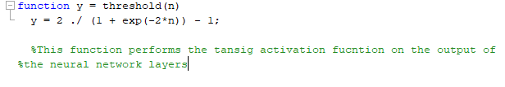

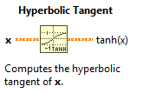
Training the Force Neural Network 8
Can be found in trainNet.m in PhD MATLAB folder.
%Set a training goal
net.trainParam.goal= 1e-6;
net.trainParam.epochs=15000;
net.layers{1}.transferFcn = 'tansig';
net.layers{2}.transferFcn = 'tansig';
net.layers{3}.transferFcn = 'tansig';
15000 epochs, training goal is an error of 1e-6.
Activation function in hidden layers and output layer
Is the sigmoid function.
Sigmoid function as handcoded in MATLAB
Can be found in function threshold.m in PhD MATLAB folder.
Sigmoid function in labVIEW

Slide 36
Training the Force Neural Network 9
Can be found in trainNet.m in PhD MATLAB folder.
% Choose a Performance Function
% For a list of all performance functions type: help nnperformance
net.performFcn = 'mse'; % Mean Squared Error
% Train the Network
[net,tr] = train(net,x,t);
% Test the Network
y = net(x);
e = gsubtract(t,y);
performance = perform(net,t,y)
Train the network
Test the network

Slide 37
Training the Force Neural Network 10
Can be found in trainNet.m in PhD MATLAB folder.
% Generate a matrix-only MATLAB function for neural network code
% generation with MATLAB Coder tools.
genFunction(net,'myNeuralNetworkFunction','MatrixOnly','yes');
y = myNeuralNetworkFunction(x);
Export the network as matrices
Trained network can be found in myNeuralNetworkFunction.m in PhD MATLAB folder.

Slide 38
Old Code for refactoring

Slide 39
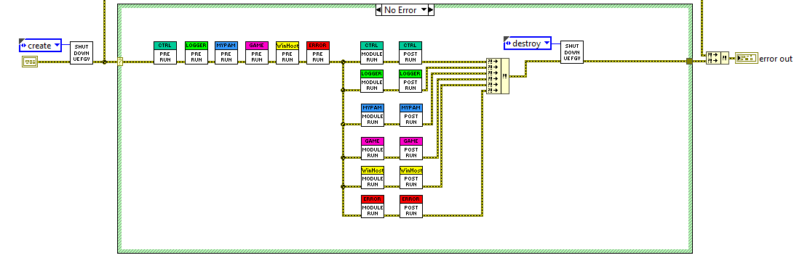
Old myRIO code 1
1.
2.
3.
4.
Current architecture.

Slide 40
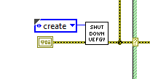
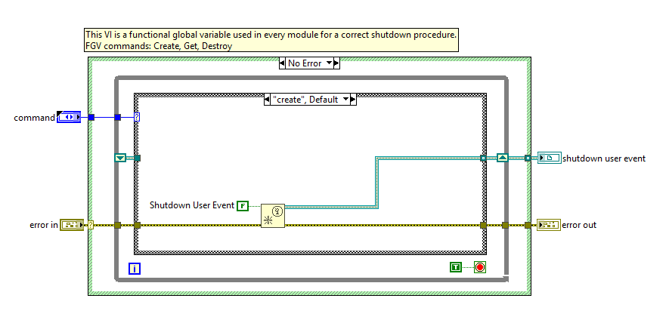
Old myRIO code 2
This is an FGV that holds a ‘Shut down’ user event.
There is a parallel loop for every main VI in section 3
which monitors this user event, waiting to shutdown the system.
I will keep this, its important for safety.

Slide 41

Old myRIO code 3
These obtain references to notifiers and queues. All notifiers and queues are in FGVs. A good system which I
Will keep, but some of these are no longer relevant since they pertain to legacy code, such as TCP comms

Slide 42
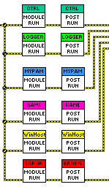
Refactoring the myRIO code 4
Row 1 controls the controller – will need to keep in some form
Row 2 controls the logging – Will Need to keep in some form
Row 3 is the low level controller - will need to keep in some form
Row 4 controls the game communication (TCP) – Now UDP with MLC
Row 5 controls the host communication. – Legacy, no longer Req
Row 6 controls the error handling. - will need to keep in some form

Slide 43
New Refactored Code

Slide 44
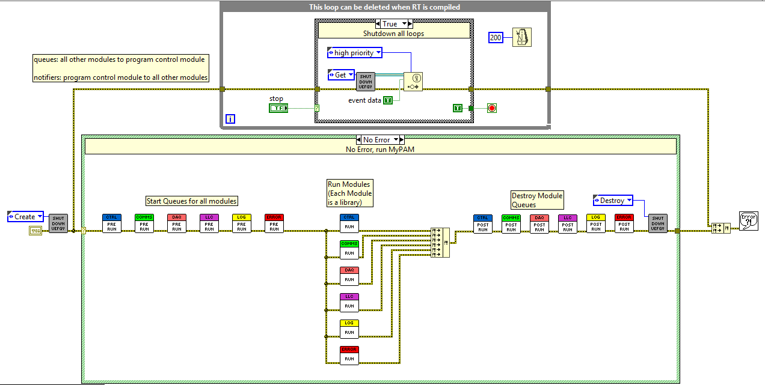
Very Similar
Main Architecture
Note that queues are not
Destroyed until all module
Loops have completed

Slide 45
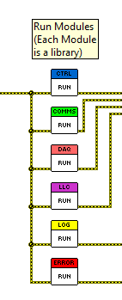
1. Program Control Module: Starts and stops all other modules
2. External Communications module: Controls UDP connection up to the MLC
And a separate UDP connection from MLC
3. DAQ Module: Performs Hardware DAQ. Currently Serial to Oran’s
Chip and i2C to my Teensy
4. Low Level Control Module: Performs the specified control type, sends motor
Demand info to FPGA
5. Logs system info, such as errors and starts etc
6. Handles Errors.

Slide 46
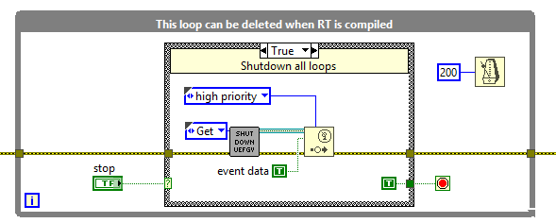
Create a shutdown event, which closes all loops when a stop button is pressed on
The RT front panel.

Slide 47
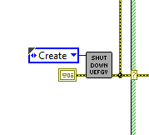
Create a Shutdown User Events Functional
Global Variable.

Slide 48

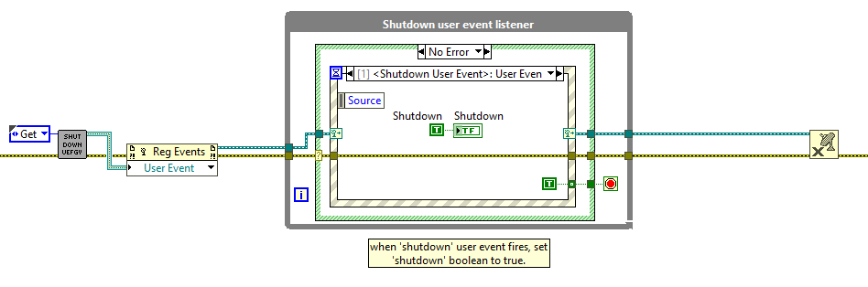
Shutdown user event fires, Shutdown is set to true,
Which forces the shutdown state for every parallel
Loop (of which there are many in each library)
These structures are in each of the module
Main VIs.

Slide 49
The next series of slides documents the queue design and initialisation

Slide 50
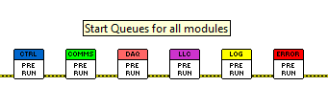
Each Module is controlled by a library. The intermodule communication occurs
With queues and notifiers, which are initialised here.
Each Module has a queue, whereby all modules (including the module in question)
may enqueue a message to a particular module.
i.e. All modules may send a message to the logging module using the logging module
Queue.
1.
2.
3.
4.
5.
6.

Slide 51
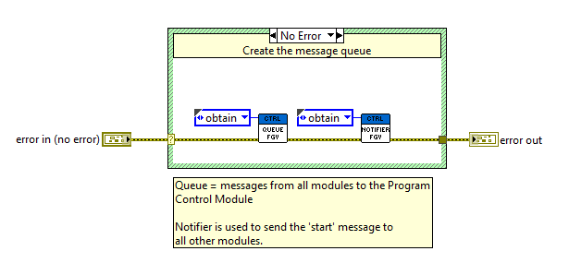
Queues 1.

Slide 52
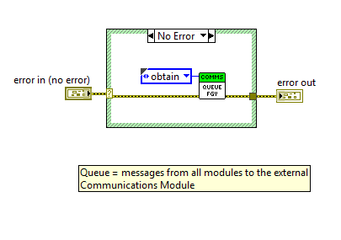
Queues 2.

Slide 53
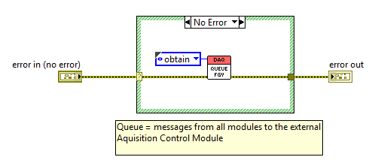
Queues 3.

Slide 54
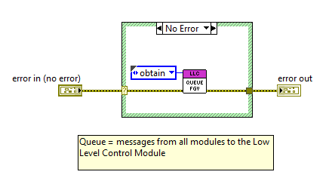
Queues 4.

Slide 55
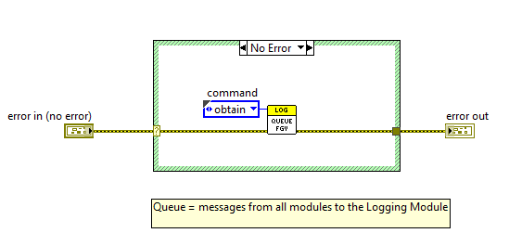
Queues 5.

Slide 56
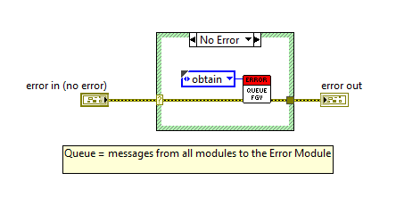
Queues 6.

Slide 57
Starting procedure
This series of slides documents the start up procedure from turning on up until the normal running of the system.

Slide 58

Starting procedure 1.
Shutdown User Event FGV is created

Slide 59
Starting procedure 2.
Queues are created

Slide 60
Starting procedure 3.
All Modules run simultaneously

Slide 61

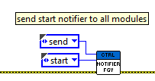
Starting procedure 4.
Program Control Module Init Phase 1: Send ‘Start’ Notifier

Slide 62
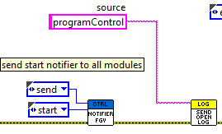
Starting procedure 5.
Program Control Module Init Phase 2: Enqueue Successful Module Start Log:

Slide 63
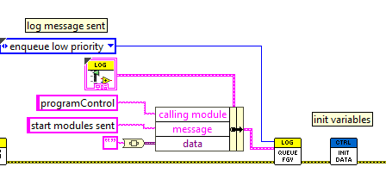
Starting procedure 6.
Program Control Module Init Phase 3: Enqueue Start Notifier Sent Log and initialise variables:

Slide 64

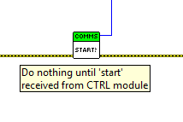
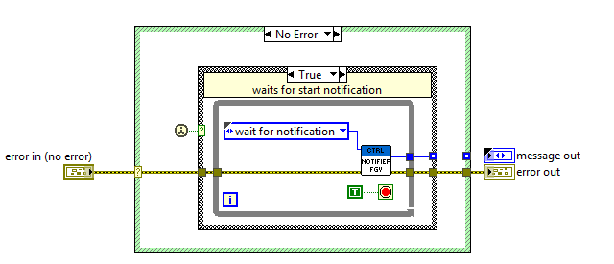
Starting procedure 7.
External Communication Module Init Phase 1: Do nothing until start notification received

Slide 65
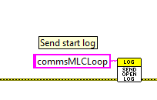
Starting procedure 8.
External Communication Module Init Phase 2: Send successful module start log:

Slide 66
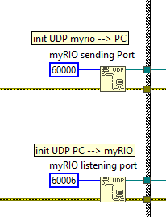
Starting procedure 9.
External Communication Module Init Phase 3: init UDP Connections:

Slide 67

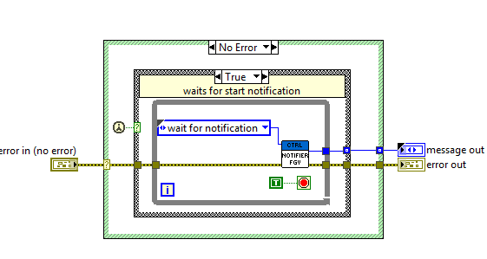

Starting procedure 10.
Data Acquisition Module Init Phase 1: Do nothing until start notification received

Slide 68
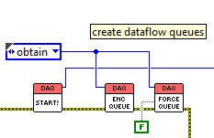
Starting procedure 11.
Data Acquisition Module Init Phase 2: Set up DAQ internal producer/consumer queues
There is 1 queue for the Encoder data, and a separate
Queue for the force data.

Slide 69

Starting procedure 12.
Data Acquisition Module Init Phase 3: Send successful encoder acquisition loop start log.

Slide 70
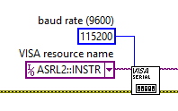
Starting procedure 13.
Data Acquisition Module Init Phase 4: initialise serial communications with Oran’s chip

Slide 71
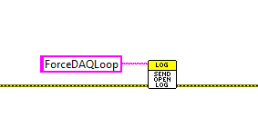
Starting procedure 14.
Data Acquisition Module Init Phase 5: Send successful force acquisition loop start log.

Slide 72

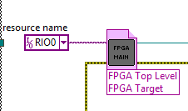
Starting procedure 15.
Low Level Control Module Init Phase 1: Open Connection to FPGA Top Level VI

Slide 73

Starting procedure 16.
Low Level Control Module Init Phase 2: Send successful module start log:

Slide 74


Starting procedure 17.
logging Module Init Phase 1: Do nothing until start notification received

Slide 75
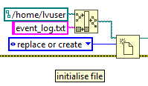
Starting procedure 18.
logging Module Init Phase 2: Open Log streaming file:
The log file can be accessed on the MyRIO:
Open internet explorer
Type in the IP Address 172.22.11.2/files
Username is admin. Password is blank
Log can be found in /home/lvuser

Slide 76
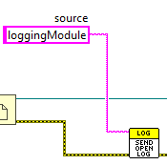
Starting procedure 19.
logging Module Init Phase 3: Send successful module start log:

Slide 77

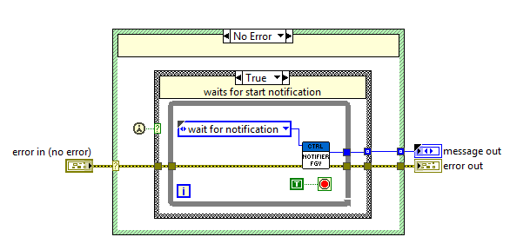
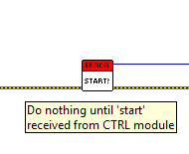
Starting procedure 20.
Error Module Init Phase 1: Do nothing until start notification received

Slide 78
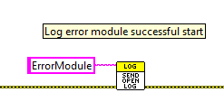
Starting procedure 21.
Error Module Init Phase 2: Send successful module start log:

Slide 79
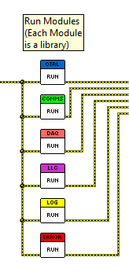
Normal Running 1
Each module runs
Simultaneously.

Slide 80
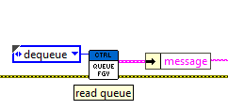
Normal Running 2: Program Control Module
Dequeue a message for handling. The message is passed
Into a case structure for handling.
Messages currently include:
Error.
Shutdown.

Slide 81


Normal Running 3: Program Control Module
Very similarly, if there is an error, generate
‘shutdown’ User Event.
If there is a ‘Shutdown’ message from
MLC, generate
‘shutdown’ User Event.

Slide 82
Normal Running 4: External Comms Module
Data is transferred by UDP:
MyRIO, IP: 172.22.11.2
MyRIO
PC, IP: 172.22.11.1
Sending Port: 60000
Listening Port: 65530
Listening Port: 60006
Sending Port: 60500

Slide 83

Normal Running 5: External Comms Module
Read the outbound data from the FGV
Convert the cluster to a JSON packet
Write the data to the outbound UDP connection

Slide 84


Normal Running 6: Get Data Out VI
Read all the Data from the Data FGV. Unbundle only the outbound data.

Slide 85

Normal Running 7: Get Data Out VI
Outbound data:

Slide 86


Normal Running 8: to JSON VI
Convert the cluster to a JSON string for transfer through UDP

Slide 87


Normal Running 9: Transmit UDP VI
Transmit the outbound
Data from the myRIO
To the PC.

Slide 88

Normal Running 10: External Comms Module
3.
1.
2.
4.
Read the inbound data from the UDP connection
Convert the JSON String to a cluster
Write the data to the FGV
Inform CTRL module of shutdown if true

Slide 89


Normal Running 11: UDP Listen VI
3.
1.
2.

Slide 90

Normal Running 12: UDP Listen VI 1
Attempt to read from the UDP connection.
3 potential outcomes:
Successful data read
Timeout error 56
Other error

Slide 91



Normal Running 13: UDP Listen VI 2
No Error, successful data read. Write the data to an FGV
Error 56, timeout. Do not write any data. Clear the error.
Other Error. Do not write any data. Do not clear the error.

Slide 92

Normal Running 14: UDP Listen VI 3
Read the data from the FGV and pass it out.
This means that the last piece of successfully acquired data
Is the data which will be used by the rest of the program.

Slide 93


Normal Running 15: from JSON VI
Convert the raw JSON string into
A cluster of input data.

Slide 94


Normal Running 16: Set Data in VI
Write data in to all data FGV

Slide 95

Normal Running 17: Set Data in VI
Data from the MLC to the myRIO:

Slide 96

Normal Running 18: External Comms Module
Check for errors. This VI is used in every loop in every module.
If any errors occur, inform the Error Handling module and then
Clear the error to prevent infinite error loops.
1.
2.
3.
Error Here
Error Here. Pass error
To Error Handling Module
Error has been cleared.
No error here.

Slide 97


Normal Running 19: Error Handler VI
Inputs: Source Module of the Error
Error
Outputs: No Error (error is cleared)

Slide 98

Normal Running 20: Error Handler VI

Slide 99


Normal Running 21: DAQ Module
This module consists of 2 producers and 2 consumers.
Module internal queues handle data transfer between them

Slide 100

Normal Running 22: DAQ Module encoder producer
Write ‘s’ to serial. When the
Chip receives this it puts data on the line
2. Read all 16 bytes of data from the serial
Line.
4.
Enqueue the unprocessed data onto the
Producer/consumer encoder queue.
Check status of stop button to decide
Which state is next.
1.
2.
3.

Slide 101

Normal Running 23: DAQ Module force producer
Write an empty byte to the teensy via
I2C, to prompt the teensy to put a data packet
onto the bus
3.
1.
2. Enqueue the unprocessed data onto the
Producer/consumer force queue.
3. Check status of stop button to decide
Which state is next.
2.

Slide 102

Normal Running 24: DAQ Module Encoder consumer
Convert the serial string to an unsigned byte array,
Rebuild the bytes into encoder counts
2. Convert the encoder counts to an angle in Radians
3. Perform the forward kinematics
1.
2.
3.

Slide 103


Normal Running 25: Scale encoder VI.
As per slides 14 and 15.

Slide 104


Normal Running 26: counts to angle VI.
As per slides 16 and 17

Slide 105


Normal Running 27: forward kinematics

Slide 106

Normal Running 28: forward kinematics 2
Note that the y offset in the above
Slide moves the origin.

Slide 107


Normal Running 29: DAQ Module force consumer
Recombine the bytes to obtain the raw
Voltage readings from the teensy
Run the raw bits through the Neural Network
To obtain Fx and Fy.
1.
2.

Slide 108



Normal Running 30: Build bits VI
Uses the ‘join numbers’ function
To rebuild the raw voltage readings

Slide 109



Normal Running 31: neural network VI
5.
4.
1.
2.
3.
Pre-processing – inputs to the network must range from 0-1,
thus divide by 1000
Hidden layer 1.
Hidden layer 2.
Output layer.
Post-processing – Newtons from -100 to 100.

Slide 110


Normal Running 32: Low Level Control Module
Read data from ‘All Data’ FGV
Low Level Control VI, generate
Motor demands according to control
Scheme.
3. Enable motors VI, generate a Boolean
For each motor.
4. Write motor information to FPGA
5. Check status of stop button to decide
Which state is next.
5.
1.
2.
4.
3.

Slide 111


Normal Running 33: Enable Motors VI
A motor is enabled when the demand
Is not 0, no matter what direction (i.e.
+ve or –ve)

Slide 112


Normal Running 34: Logging Module
1. Get a message from the queue
2. Format the message correctly
3. Set the log to write at the end
Of the file.
5.
4. Write the log
1.
2.
3.
4.
5. Check status of stop button to decide
Which state is next.

Slide 113

Normal Running 35: Format log VI
Require the log to be in the following format:
1.
Timestamp
Calling Module
Message
Error Number
Error Source
2.
Timestamp
Calling Module
Message
Error Number
Error Source
3.
Timestamp
Calling Module
Message
Error Number
Error Source
4.
Timestamp
Calling Module
Message
Error Number
Error Source
5.
Timestamp
Calling Module
Message
Error Number
Error Source

Slide 114

Normal Running 36: Format log VI
2.
1.
3.
1: unbundle message, 2: Parse error (if error exists), 3: Format log into string

Slide 115


Normal Running 37: Error Handling Module
Receive Error Message
Log Error and Source
Inform Program Control Module of Error
Determine next state.
4.
1.
2.
3.

Slide 116


Normal Running 38: Send Error Log VI
Enqueue error log at front
Of log queue

Slide 117


Normal Running 39: Send Error Log VI
Inform program
Control module
That an error has
Occurred.
Error location
“Error”

Slide 118
Normal Running 40: Common Errors
DAQ Module: I2C Error -363011. This error occurs when the I2C comms has failed. During testing,
this typically occurs when the SCL or SDA lines are switched, or one of them is disconnected. If the
cable is reconnected whilst code is running, the error typically disappears.
DAQ Module: Serial Error/warning 1073676294. This error occurs when the serial comms has failed. During testing,
this typically occurs when the lines aren’t physically connected. During testing it has become apparent that this warning
Almost always is present, even when things are working well.
External Comms Module: UDP Read Timeout Error 56. This error occurs trying to read UDP data when there
is none on the wire. This error is handled internally in the external comms module, and should never be noticed
by the user.

Slide 119
FPGA
The FPGA is responsible only for controlling the motors. It does not perform any DAQ.
INPUTS: Motor demand, motor direction, motor enable/disable
OUTPUTS: Motor enable/disable, Motor direction, Motor PWM

Slide 120

FPGA 1
INPUTS

Slide 121

FPGA 2
Initialisation:
Set demands to 0 and disable motors to
Ensure that the robot does not move upon
Startup.
There is a dataflow dependency on the Boolean
Which ensures that no other FPGA code runs
Until the initialisation is complete.

Slide 122

FPGA 3
Connected as per slide 3 of this document

Slide 123

FPGA 4
This loop calculates the Duty Cycle from the demand, and also sets the motor direction

Slide 124

FPGA 5
This loop writes the PWM to the motor control boards

Slide 125

Admittance Control Library
This library is used within the LowLevelControl Module.
Inputs: PID Gains, Admittance Gains, All Data/
Outputs: Motor 1 direction and demand (0-100), Motor 2 direction and demand (0-100)

Slide 126


Admittance Control Library 2
1st action is to check whether assistance is enabled.
If enabled, move to control as normal.
If disabled, no control will be performed.

Slide 127

Admittance Control Library 3
With Assistance enabled, the first action
Is to extract the necessary control data from the
‘All Data’ FGV

Slide 128

Admittance Control Library 4
2 actions then occur in parallel.
It is determined if there is a new target
(and also if the game or the controller is
In charge of trajectory generation).
2. It is determined whether the target has been met.
1.
2.

Slide 129


Admittance Control Library 5
If the xposition = xtarget (within deadzone)
AND
If the yposition = ytarget (within deadzone)
The program outputs a ‘1’, which is used to
Turn off control further along.

Slide 130


Admittance Control Library 6
Determines if the target is new or not. If a new target, a Boolean is output
To the PID further along to reset Integral.
Determines if the target is new or not. If a new target, a Boolean is output
To the PID further along to reset Integral and also Min Jerk Parameters are reset.
Then, next position is calculated by min jerk trajectory.

Slide 131


Admittance Control Library 7
3.
1.
2.
1. Determine if new target.
2. Set initial conditions for new min jerk trajectory if new target.
3. Reset FGV timer for min jerk trajectory if new target.

Slide 132


Admittance Control Library 7
Calculate the next point on the minimum jerk trajectory according to the equation

Slide 133


Admittance Control Library 8
If target not met, generate motor demands
If target met, generate no motor demands

Slide 134
Admittance Control Library 8
Forces go through admittance filter
Inverse kinematics derive next desired
Point.
3. Position PID generates motor demands
1.
2.
3.

Slide 135


Admittance Control Library 9
Apply admittance filter as per equation derived.

Slide 136



Admittance Control Library 10
CHECK OUTPUT IN RADDDDDD. NEED OUTPUT IN RAD!!!!!!!!!!!!!!!!!!!!!!!!!!!!

Slide 137


Admittance Control Library 11
1.
3.
4.
2.
1. All angles in radians
3. Convert -100 – 100 to 0-100 and direction
2. PID control. Integral is reset when new target
4. Output demand 0-100 and directions

